Slide 1








IHE-HL7 Gemini SES+MDI – Ecosystem Pathway – Foundations & Operationalization
Updated: 2022.02.15
FHIR is a trademark of Health Level 7, International.
SDC is a registered trademark of OR.NET

Slide 2
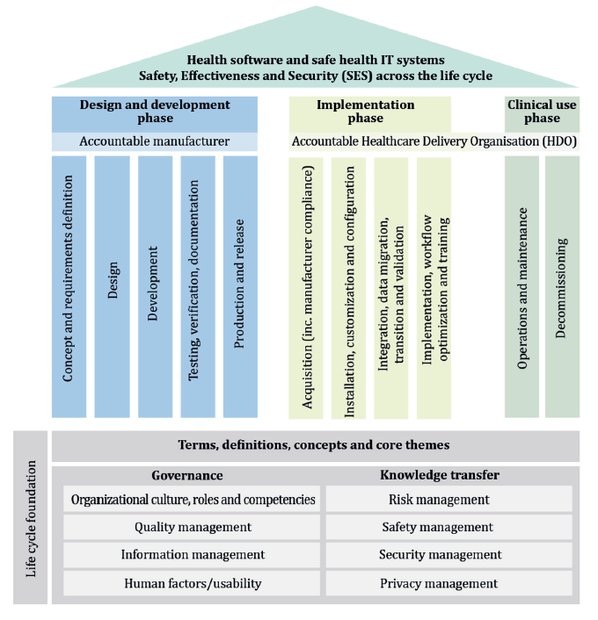
Gemini SES+MDI Ecosystem Pathway Operationalization
Developing SES EP Requirements & Guidance (How)
SES Standards Context for application to the Gemini Project
Formalizing SES EP Guidance (What)
Focus: Role of the IEEE 11073-1070x PKP Standards

Slide 3
Gemini SES+MDI / Ecosystem Pathway – Developing Requirements & Guidance
How will the EP work group accomplish its charter of developing SES requirements and guidance for a product development pathway to a trusted ecosystem of component products?

Slide 4
Gemini EP Objective
Objective: Develop open, consensus requirements and guidance for a total product life cycle pathway that enables the establishment of a multi-vendor ecosystem of independently developed (“decoupled”) plug-and-trust component products that contribute to a defined set of clinical system functions – safely, effectively & securely (SES), utilizing the SDC/SDPi+FHIR medical device interoperability (MDI) standards
Note: Not an abstract exercise!
Specific implementations of Specific standards (SES+MDI) for
specific products deployed in Specific acute care contexts to achieve
Specific clinical functions.

Slide 5
Gemini EP Work Group Operating Principles
Core principles for how the group will achieve its objective:
Open Operates under IHE-HL7 Governance but no firewalls, up-front membership requirements, publicly viewable / transparent, etc.
Consensus Agreement of those who care, silence of those who don’t
(Requires participation of the appropriate stakeholder experts!)
SES Standards Application of existing “foundational” standards (e.g., 80001-1)
MDI Standards Application focus is on the SDC/SDPi+FHIR standards framework
SES Requirements Guidance will focus on specific, testable requirements
Total Product Life Cycle Pathway will include the entire lifecycle from concept to market to implementation to use to decommissioning

Slide 6
Gemini EP Process & Deliverable “Artifacts”
Hmmmm…
All content is captured & publicly available at …
https://confluence.hl7.org/display/GP/Pathway+to+an+Ecosystem+of+Plug-and-Trust+Products
Topics of Interest Table
Topic Resolution
Formalized in SES+MDI Artifacts
Meeting Discussion Notes
Consensus statement with specific requirements + guidelines, and where they will be implemented
Topic Discussion Pages
(See subsequent section for details on “artifacts”)
Gemini “sdpi-fhir” Github repository folders provided @
github.com/IHE/sdpi-fhir/tree/master/Ecosystem Pathway

Slide 7
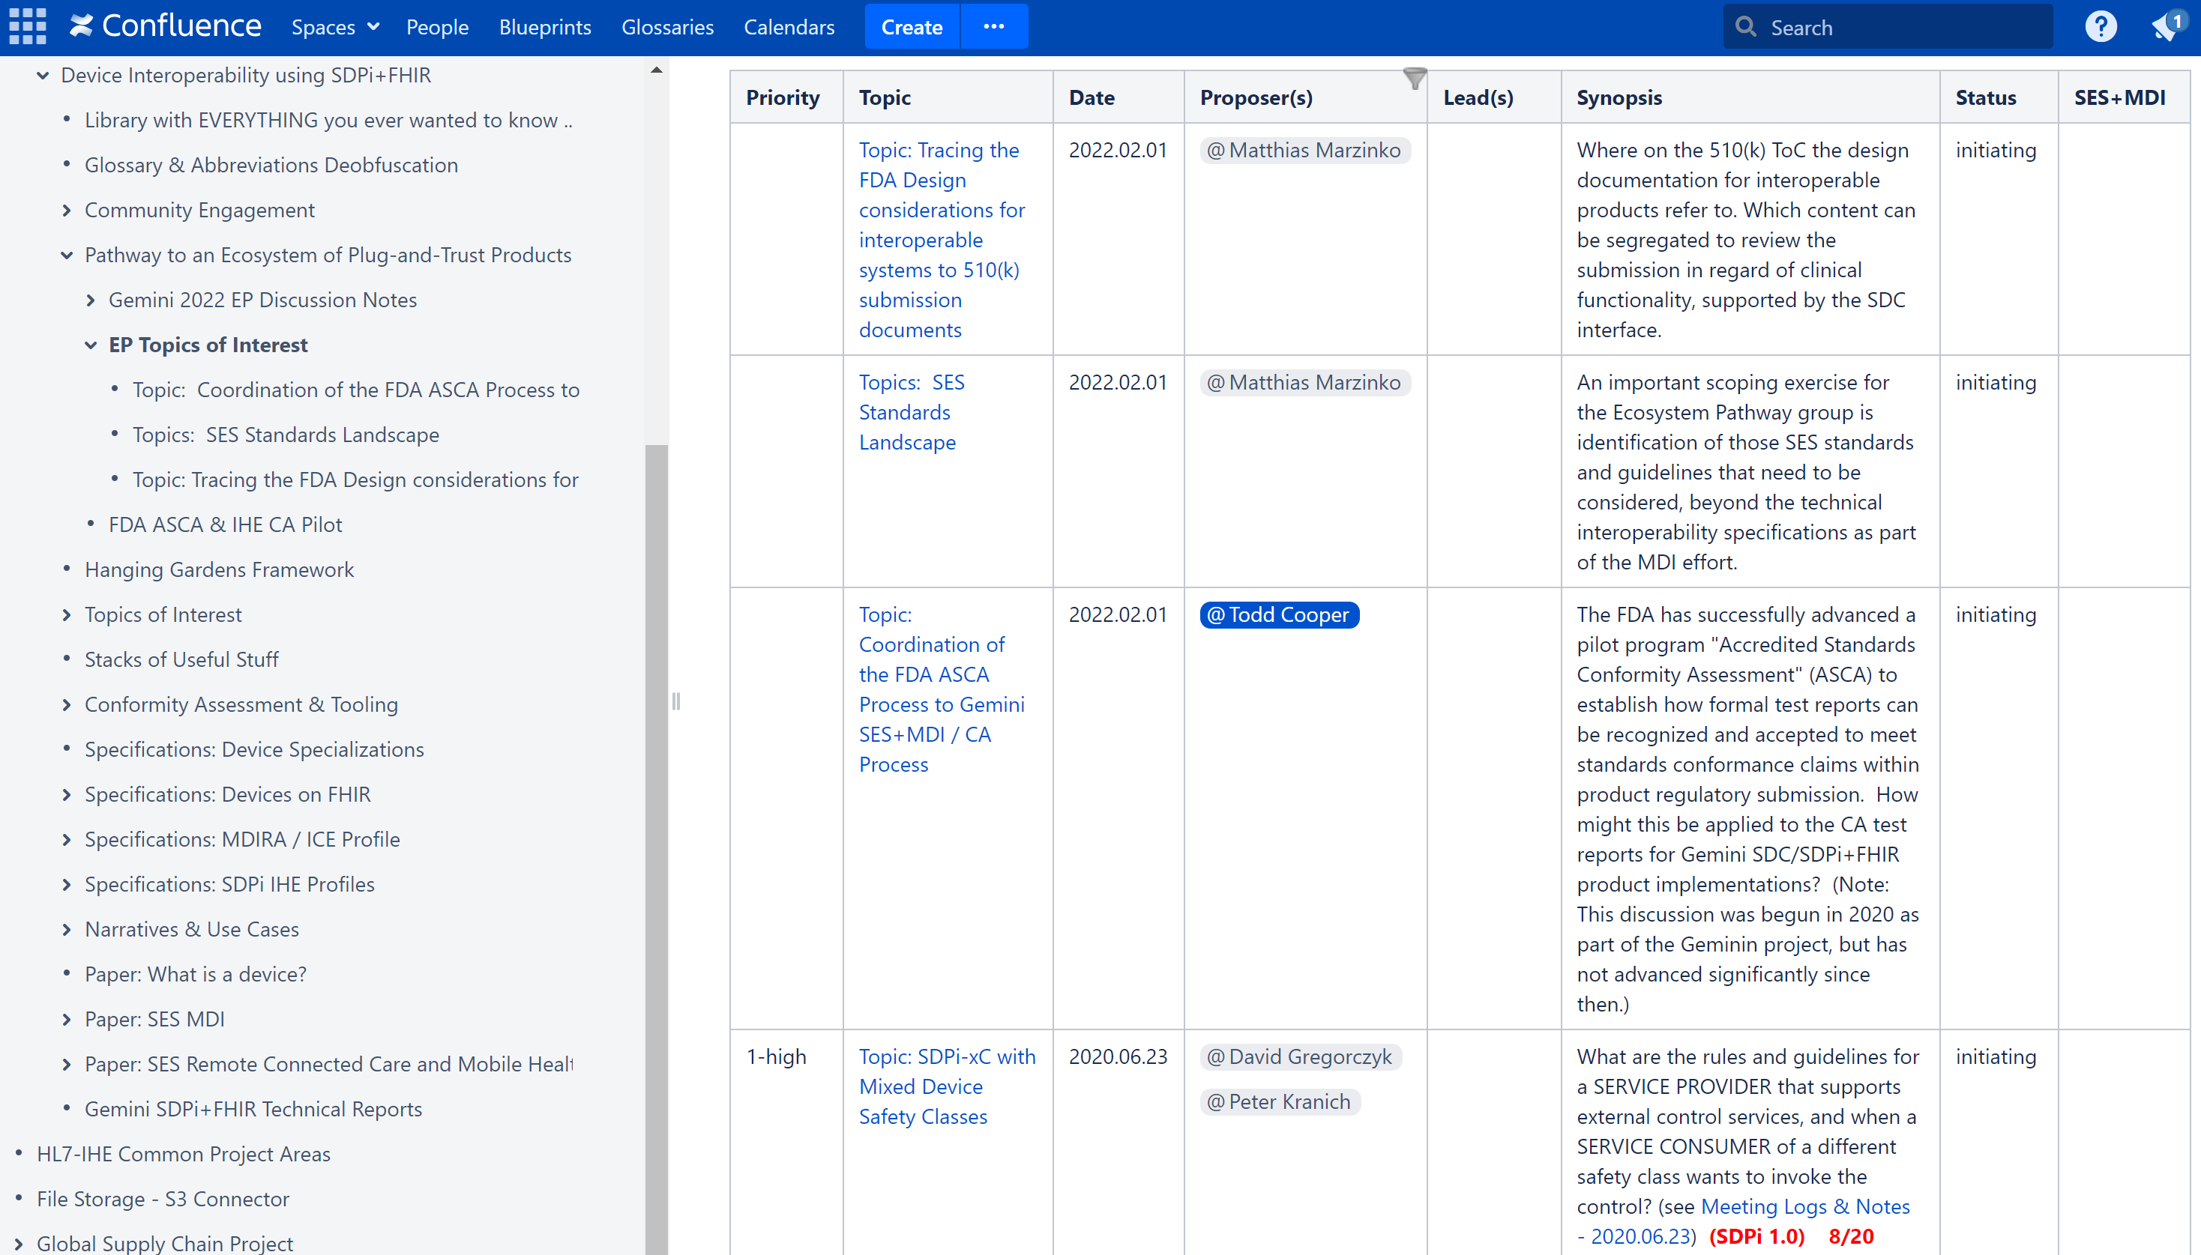
Gemini EP “Topics of Interest” Table
Topics of Interest Table
Topic Resolution
Topic “row” created (need Confluence acc’t)
Short “Topic: …“ name created; proposal Date & Proposer(s) w/ Interested Parties & Synopsis created; Status=“initiating”
EP group review & acceptance; Priority & Lead(s) set, sub “Topic Discussion” page created and linked to Topic text; Status=“discussing”
Lead(s) manage discussion and resolution
Priority indicates which topics the group needs to resolve first (synched with EP Roadmap)
Topic Resolution is memorialized at the top of its specific discussion page & status updated to the ToI Table
Resolutions include which EP “artifacts” are to be created and updated as a result of the discussion
Topic Discussion Pages
(See EP “Topics of Interest” Table)

Slide 8
Gemini EP Roadmap Development
Ecosystem Pathway Roadmap to be developed …
3+ Year Window
Major product pathway milestones including 1st product Conformity Assessment “RR” test report capability
Factor in “priorities” / resolutions / artifacts from “Topics of Interest” discussions
Coordinate with other roadmap workstreams, including MDI Technical (SDC/SDPi+FHIR and MDIRA profile specifications), CA & Tooling, Testing (CAT & PAT) & Demo & Educational/ Workshop events, etc.
See also “Requirements & Guidance” section below

Slide 9
Gemini SES+MDI / Ecosystem Pathway – SES Standards Landscape Context
The EP effort does not start from scratch with a blank slate – there are a core set of foundational standards and specifications – both MDI and SES – that are to be evaluated and appropriately applied. Understanding this standards landscape context significantly focuses the work of the group!

Slide 10
Gemini EP SES Standards Objective
Objective: Identify and apply existing quality, safety, security – SES – standards to SDC/SDPi+FHIR – MDI – ecosystem product implementations, specifying the relevant principles, requirements and guidance, along with the V&V that will ensure their proper use across all components. Gaps and revisions may be proposed back to the responsible authors.
Note: We know these standards!
Consistent linkages to SDC/SDPi+FHIR standards +
Consistent implementation & Conformity Assessment of products
is another problem altogether!

Slide 11
JWG7 SES “Temple” Diagram
Model developed over last 10 years in response to better manage the interrelations …
Across Stakeholders …
Across Product Lifecycles …
Across Subject Areas
Across Multiple Standards
82304-1
80001-1
SES+
MDI Trust Gap!
Problem: SES+MDI “Trust Gap” recognized but no practical real-world solutions – too resource & labor intensive
81001-1
Source: ISO/IEC 81001-1:2021

Slide 12
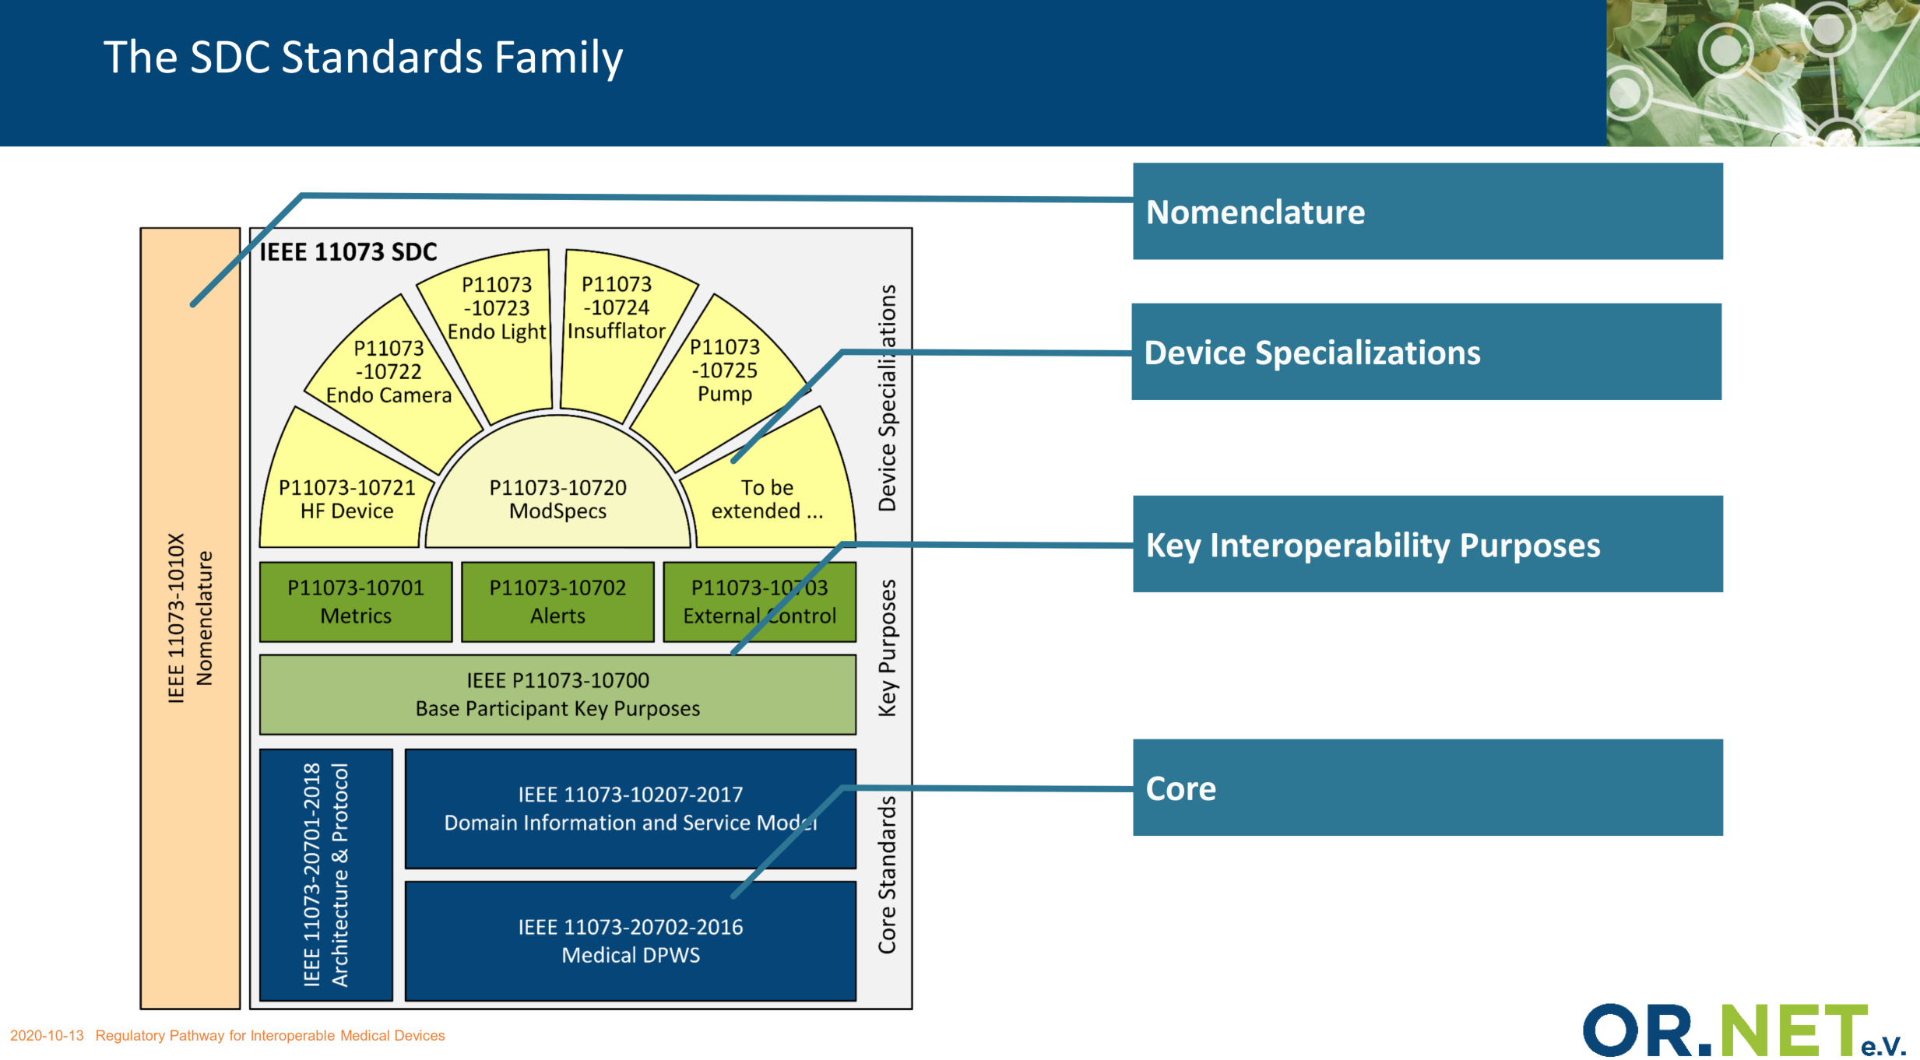
ISO/IEEE 11073 SDC MDI “Cathedral” Model
“Cathedral” Model

Slide 13

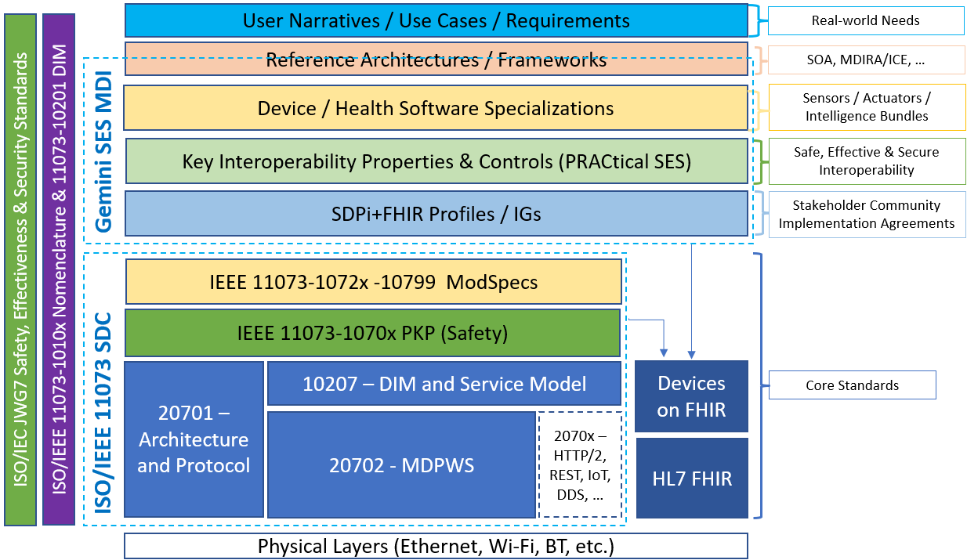
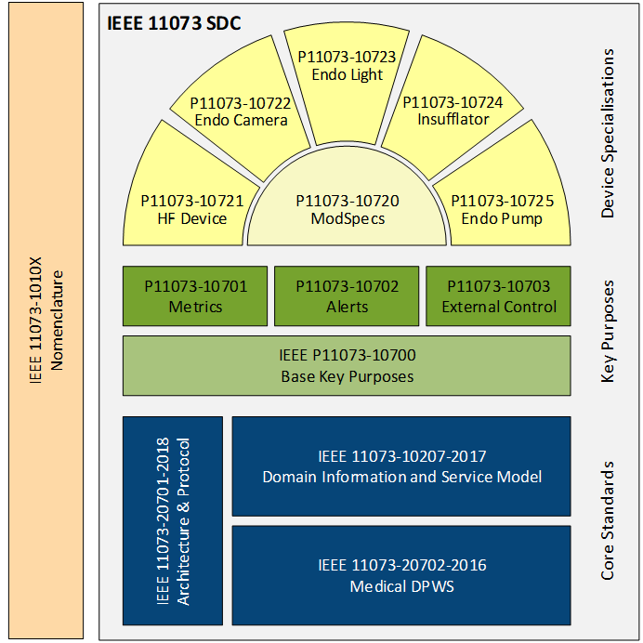
Gemini SES+MDI “Hanging Gardens” Framework
SES+MDI Plug-n-Trust Interface
(More @ https://confluence.hl7.org/x/4ijxB)

Slide 14
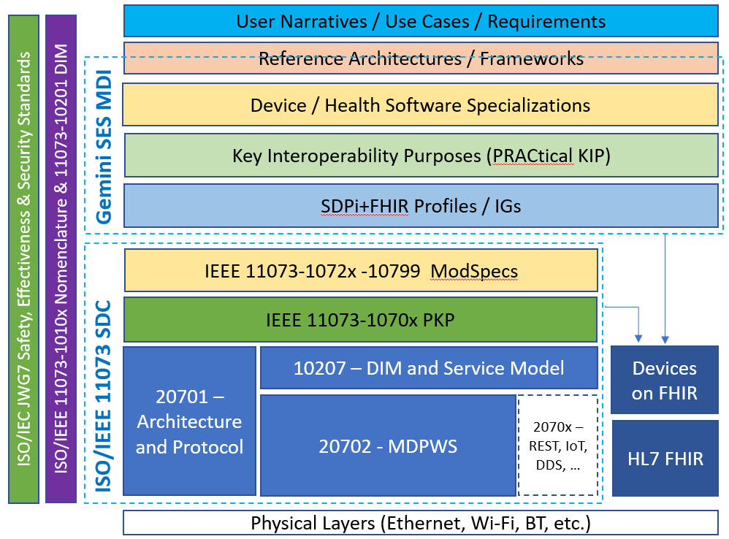
Gemini SES+MDI & Ecosystem Pathway …
Problem? Ecosystem Pathway group will leverage the SES+MDI “Hanging Gardens” Framework …
to address the pesky “Trust Gap” product ecosystem challenges!
SES+
MDI Trust Gap!
14

Slide 15
Gemini EP SES Standards Landscape
Ecosystem Pathway will …
Identify existing SES standards relevant to establishing Plug-n-Trust product ecosystem (along with the scope and rationale for their use)
Determine how the requirements from each standard should be applied (both in principle and specifically / concretely)
Integrate SES requirements / principles / guidelines with MDI SDC/SDPi+FHIR technology (SES requirement <X> is addressed by MDI <xyz> requirements / capabilities)
Specify how standards-specific conformity will be determined and by whom (IHE CAT/CA vs. company-product-specific V&V)
Provide feedback as appropriate to standards developers regarding gaps & issues (recognizing that SES+MDI may include near term “workarounds”)
Note: Not detailed here, but wholly applicable, is the EP role in advancing “requirements interoperability” (e.g., 80001-1 with PKPs) and “regulatory submission ready” test reports with traceability and coverage.

Slide 16
Gemini SES+MDI / Ecosystem Pathway – Formalizing Requirements & Guidance
As the EP group works through its issues and tasks, WHAT will they do with the requirements & guidance that is developed? What documents will be created or updated? What artifacts for conformity assessment and testing are created to ensure that at the end of the day, implementers following the product ecosystem pathway, can trust that everyone got to the same place without leaving out any steps?

Slide 17
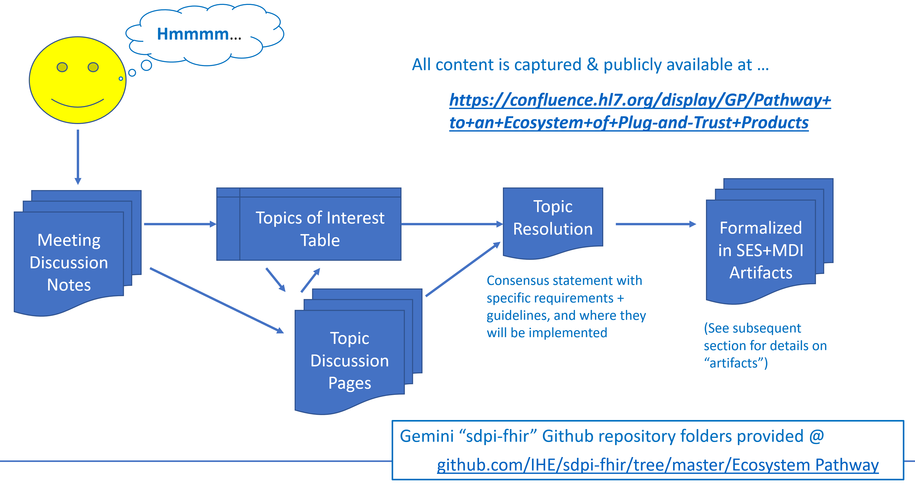
Gemini EP Formalizing Requirements & Guidance
Ecosystem Pathway Guidance document
“Start here…” source for all EP community discussions & deliverables
EP “Cookbook” approach
PnT Ecosystem IFU Template
See EP confluence page home
IHE SDPi Supplement document
“SES” section content
SES standard conformity sections + principles & guidelines
Use Case SES requirements
Testing & Conformity Assessment artifacts
V&V Process for PnT Ecosystem
Test plans & protocols
Test Report Template (for “RR”)
Educational Materials

Slide 18
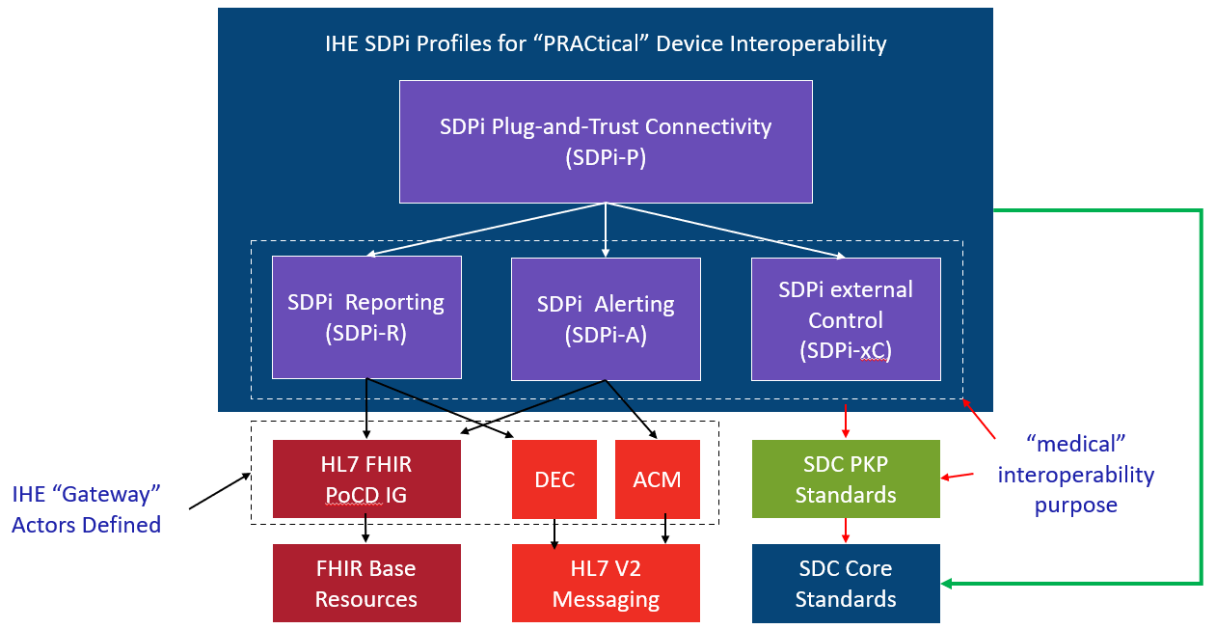
IHE Devices Technical Framework: SDPi Profiles Supplement
Service-oriented Device Point-of-care Interoperability (SDPi)
Four profile specifications:
SDPi-P for Plug-and-Trust Interoperability
SDPi-R for Reporting Medical Information
SDPi-A for Alerting
SDPi-xC for External Controlling
Three IHE DEV TF Volumes:
TF-1 Profiles / use cases / actors / …
TF-2 Transactions / MDPWS messaging
TF-3 BICEPS content modules / device specializations
EP SES / PKP Application Core Need
See draft SDPi Supplement Word Document for additional content detail & outline (https://github.com/IHE/sdpi-fhir/tree/master/SDPi%20%20Supplement/SDPi%20Rev%201.0)

Slide 19
SDPi Tour: From Volume 1 to 2 to 3
EP SES Content Fully Integrated
SDPi TF Supplement Vol.1 Integration Profiles
SDPi-P Profile
Profile Actors & Transactions & Content Modules
Profile Actor Options
Profile Overview (Concepts & Use Cases)
SES Considerations
SDPi-Reporting Profile …
SDPi-Alerting Profile …
SDPi-xControl Profile …
Appendix A: Requirements Management for Plug-n-Trust Interoperability
Appendix B: Referenced Standards Requirements Coverage
<including ISO/IEEE 11073 SDC PKP tables>
Appendix C: Device Point-of-care Interoperability Use Cases
<including Gherkin detail & SES Considerations etc.>
SDPi TF Supplement Vol.2 Transactions
DEV-23 Announce Network Presence
Scope
Actor Roles & Referenced Standards
Messages (at BICEPS level w/ links to Appendix A)
Protocol Requirements
SES Considerations
DEV-24 Discover Network Participants
…
DEV-44 Invoke Medical Control Services
Appendix A: ISO/IEEE 11073 SDC / MDPWS Message Specifications (Normative)
SDC/BICEPS to SDC/MDPWS Message Specifications
Messages for BICEPS Discovery Model
<specific MDPWS message links>
<example exchanges & library calls>
M:N Profiles & Transactions
See SDPi Supplement (1.0) document in the IHE sdpi-fhir Github repository for full details.

Slide 20
SDPi “RI” – Starter Model @ SES
DEV TF
TF-1 Profile
TF-2 Transaction
TF-3 Content Module
Profile SES
Transaction SES
Content SES
NOTE: 11073-1070x PKPs linked here from TF-1 Appendix B ICS Tables will be a primary source of these requirements
“is a”
SES Requirement
“has a”
1..1
0..1
0..1
0..1
SES General
SES Safety
SES Effectiveness
SES Security

Slide 21
Next Step: Requirements Interoperability Pilot
Hanging Gardens Layer
SDPi 1.0 – Basic RI
STANDARDS
SDPi TF Sections
User Narratives / Use Cases / Requirements
SORD & SPoC & SICU TF-1 Apdx. C + Profile Specific Map.
Reference Architectures / Frameworks
MD-SOA (SDC Core) TF-1 SDPi Profiles Overview
Device / Health Software Specializations
IHE TF-3 & X73 Stds. TF-3 BICEPS sections
Key Interoperability Properties & Controls (PRACtical SES)
(Null layer) TF-1 Apdx. A “SES MDI” Section
ISO/IEC JWG7 Safety, Effectiveness & Security Standards
80001-1 (2nd Ed.), Annex A TF-1 Apdx. B + TF SES Sections
SDPi+FHIR Profiles / IGs
(opt) PIXm / PDQm TF-1 SDPi-P FHIR (in) Gateway
IEEE 11073-1072x -10799 ModSpecs
(Null layer)
IEEE 11073-1070x PKP (Safety)
11073-1070x ICS + R’s? TF-1/-2/-3 SDPi SES Sections
ISO/IEEE 11073-1010x Nomenclature & 11073-10201 DIM
RTMMS + DIM ICS Tables? TF-3 + TF-1 “Content Profiles” Sections
10207 – DIM and Service Model
ICS Tables + Rxxxx’s? TF-1 Apdx. B + Profile Mappings
10207 – DIM and Service Model
20701 – Architecture and Protocol
ICS Tables + Rxxxx’s? TF-1 Apdx.B + TF-1 & TF-2 Trans.
20702 - MDPWS
ICS Tables + Rxxxx’s? TF-1 Apdx. B+TF-2 Apdx. A+Trans
( BLUE = Priority Roadmap & RI items + RED indicate normative RI Items)

Slide 22
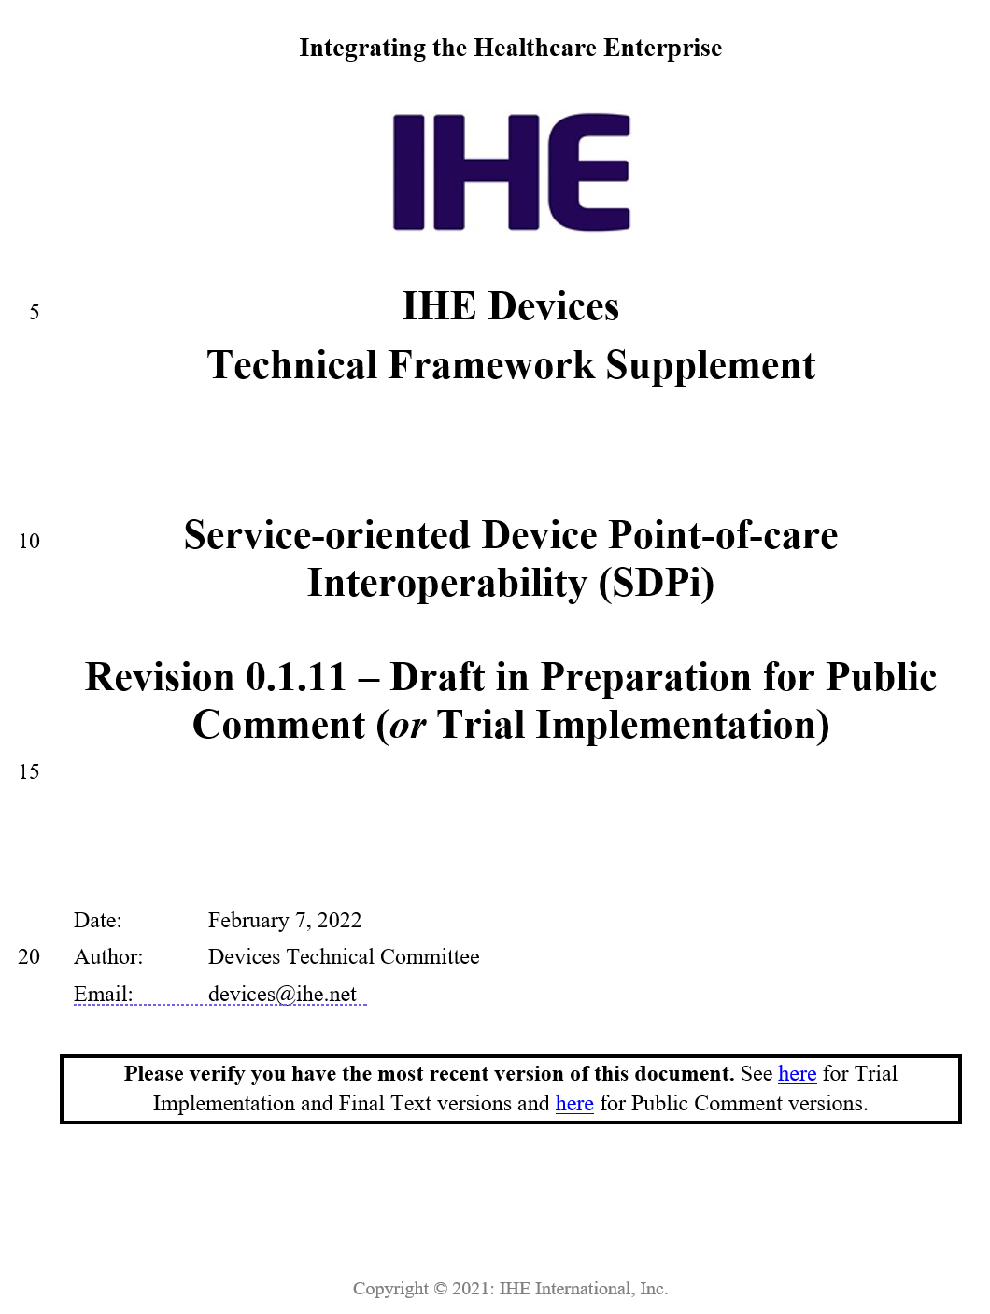
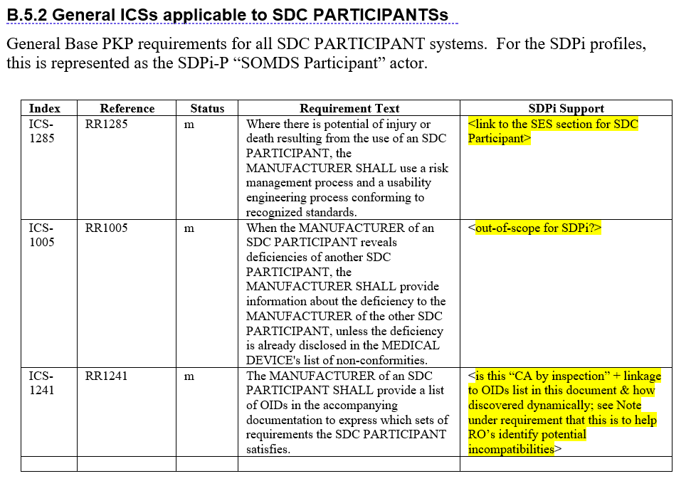
Gemini EP – Application of SES Standards
Draft 11073-10700 Implementation Conformance Statement (ICS) Table

Slide 23
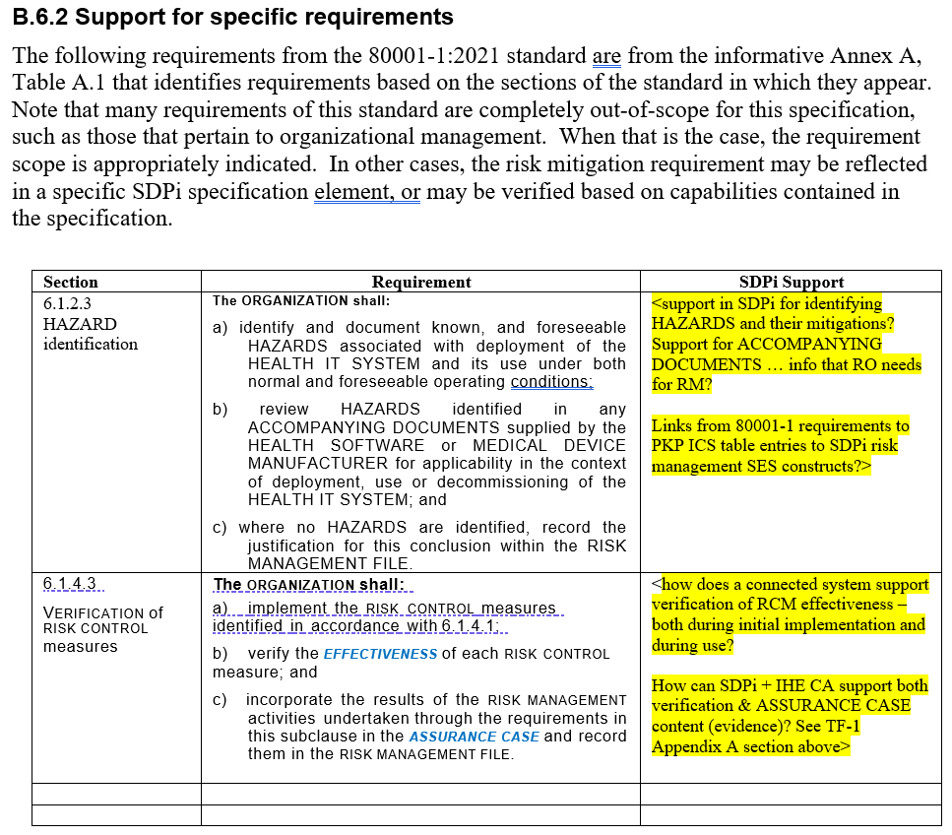
Gemini EP – Application of SES Standards
ISO/IEC 80001-1:2021, Appendix A
Note: 80001-1 referenced informatively from 11073-10700

Slide 24
Gemini EP Deliverables & Artifacts
Ecosystem Pathway will create …
Multi-year (3+) EP Roadmap leading to a point where an ecosystem PnT products can be assessed for conformity, placed into use, and monitored for SES+MDI
Guidance document that will serve as the primary resource for the principles, requirements and guidelines for achieving SES+MDI across the product ecosystem
SES content in the SDC/SDPi+FHIR specification documents (w/ requirements interoperability)
Test and Conformity Acceptance requirements, principles, guidelines (incl. test cases, scripts, etc.)
Test Report template (in support of “regulatory submission ready”)
Educational materials + workshops, roundtables, etc.
Note: Formal “deliverables” governance (approval / balloting) and publication will be under the auspices of IHE and HL7; however, the specific details have yet to be finalized.

Slide 25
Gemini SES+MDI / Ecosystem Pathway – Role of the IEEE 11073-1070x PKP’s
One key focus of the EP discussions will be to effectively integrate the requirements of the IEEE 11073-1070x Participant Key Purposes (PKP) standards, which will provide a core consensus set of risk mitigations within the ISO/IEEE 11073 Service-oriented Device Connectivity (SDC) family of interoperability standards.

Slide 26
Gemini EP Role of 11073 PKP Standards
Challenge: Achieving an SES+MDI ecosystem of Plug-and-Trust component products includes multi-vendor shared risk and requires …
All stakeholders contribute to and have confidence in the pathway elements that lay the basis for SES+MDI trustworthiness
Each product (manufacturer) fully adheres to SES pathway requirements & guidelines – verified by product CA & discoverable at run-time
Each product (manufacturer) can “trust but verify” in real-time that the other products are operating in a trustworthy way
Systems of products can be monitored and managed in real-time to ensure SES+MDI is achieved and maintained
Objective: Ecosystem Product Pathway must integrate an open consensus risk management process, including implementation of the IEEE 11073-1070x Participant Key Purposes (draft) standards

Slide 27
Gemini EP Role of 11073 PKP Standards
EP Managed
Fully integrated into the Gemini SES+MDI standards landscape!
80001-1
SES+
MDI Trust Gap!

Slide 28
Gemini EP Role of 11073 PKP Standards
EP Managed
IEEE 11073-1070x Participant Key Purposes standards provide …
Shared / consensus risk management
Safety, Security & Interoperability focused
Scoped to 11073 SDC Plug-and-Trust MDI
Risks, Controls, IFU, etc.
For an Ecosystem of SDC/SDPi+FHIR Plug-and-Trust Component Products!
Note: See overview and status update presentations in Ecosystem Pathway / Reference Materials confluence page

Slide 29
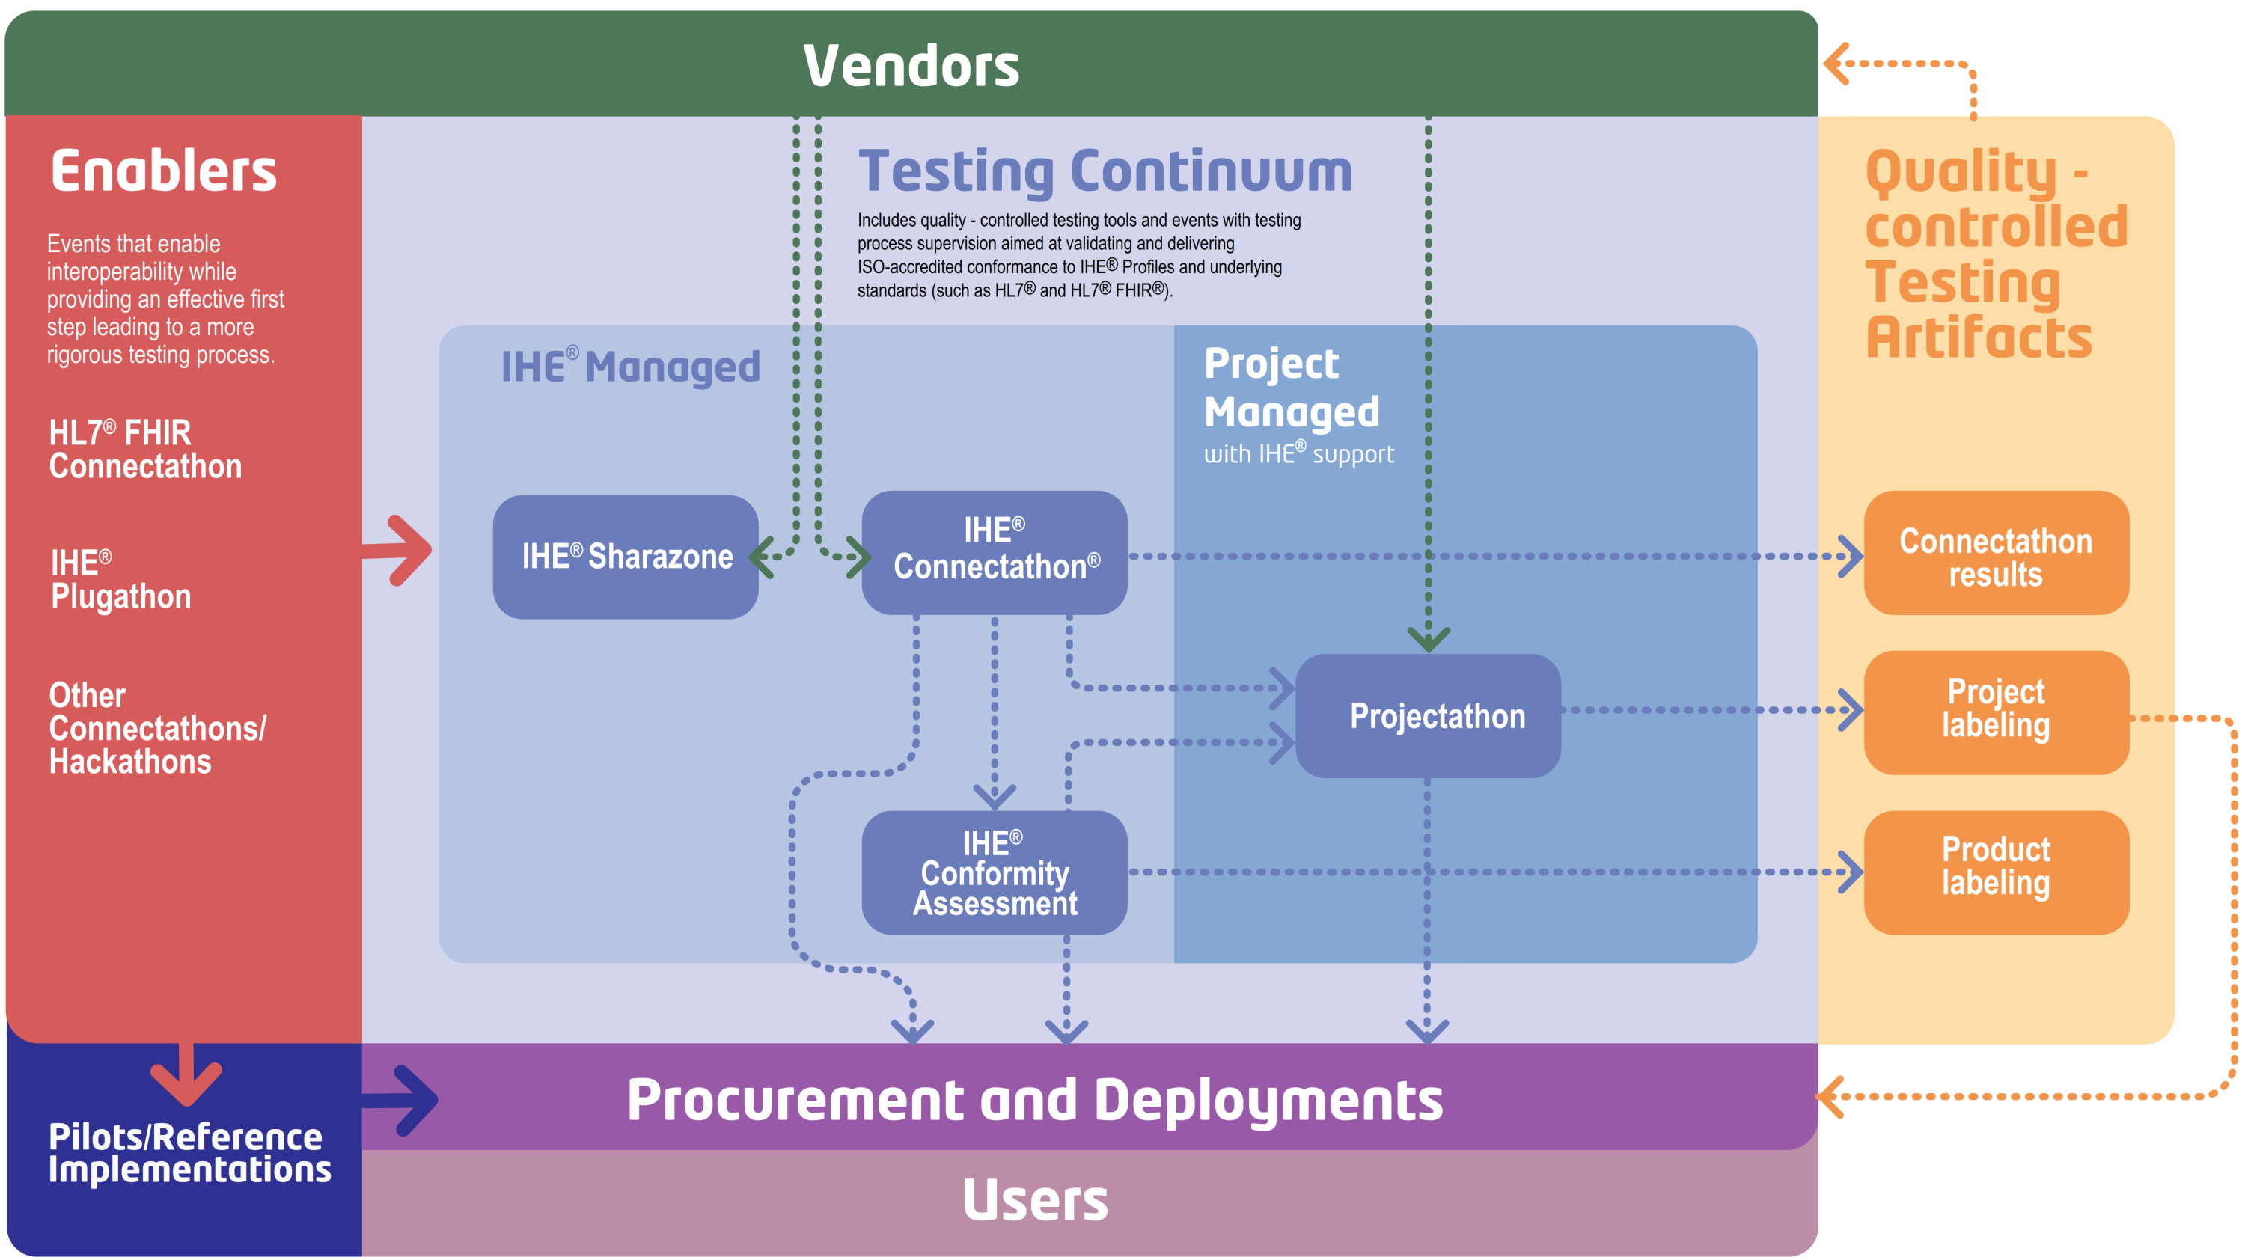
Gemini EP From PKPs to Product CA
EP Managed
Traceability & Coverage back to 11073-1070x PKP ICS Specifications (via “RI”)
IEEE 11073-1070x Project Teams
Gemini SES+MDI Community
CA “RR”
Test Report
Develop
Develop
11073-1070x PKP Standards
IHE SDPi TF Specifications (TF-1 / Appendix B)
SES+MDI SDC/SDPi+FHIR
Test Plans/Scripts + PAT/CAT + Product CA
Require-ments
PKP ICS Tables

Slide 30
Gemini EP Role of 11073 PKP Standards
EP Managed
And there’s more …
SES of “gateway” actors (FHIR & V2)?
MDIRA profile role in SDPi SES+MDI?
Runtime computable “IFU” for SoP operational health?
CA programs like FDA ASCA Pilot?
Composable / computable SES+MDI Assurance Cases?
Simulation enabled by “model centric” use of MBSE / SysML2.0?
Note: See PKP overview and status update presentations in Ecosystem Pathway / Reference Materials confluence page

Slide 31
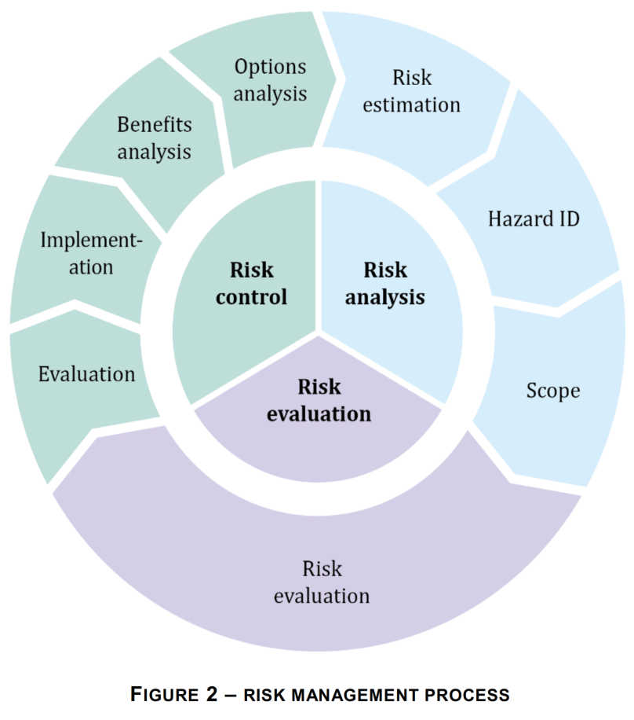
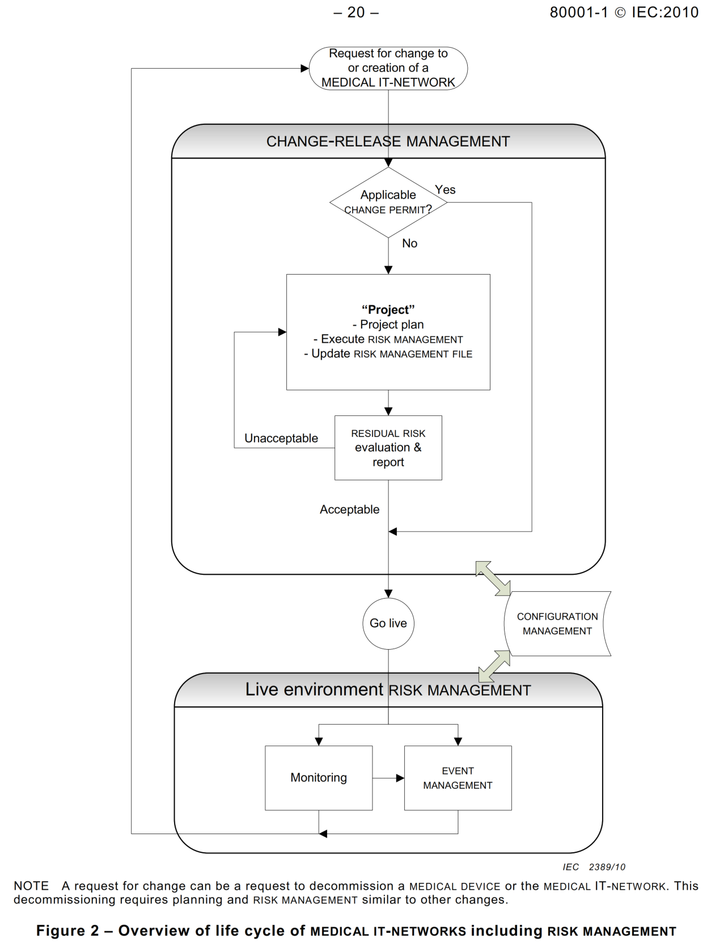
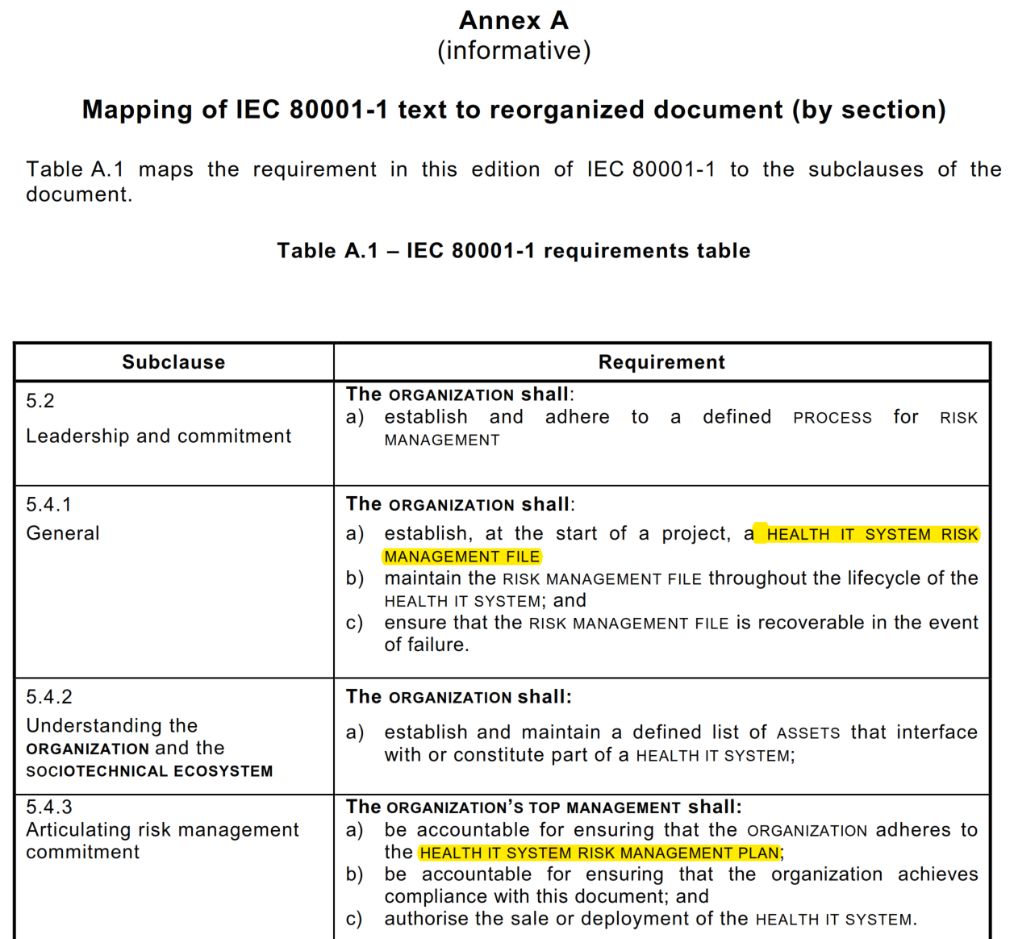
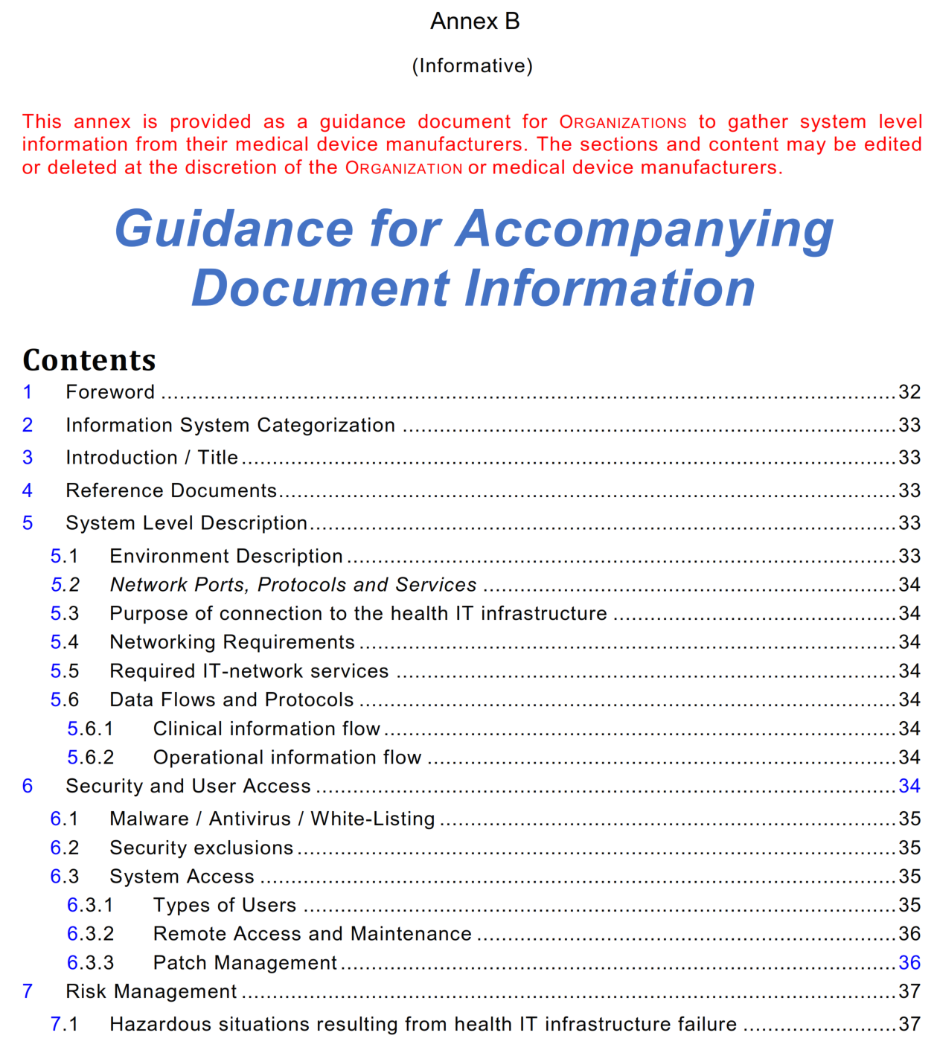
Gemini EP – SES+MDI Trust Gap?
EP Managed
80001-1:2021 2nd Edition
80001-1:2010 Edition “Life cycle” Model
80001-1
SES+
MDI Trust Gap!
Risk Management in a multi-vendor “decoupled” plug-and-trust product ecosystem?

Slide 32
IHE-HL7 Gemini SES+MDI – Ecosystem Pathway – Foundations & Operationalization
FHIR is a trademark of Health Level 7, International.
SDC is a registered trademark of OR.NET

Slide 33
Additional Materials

Slide 34
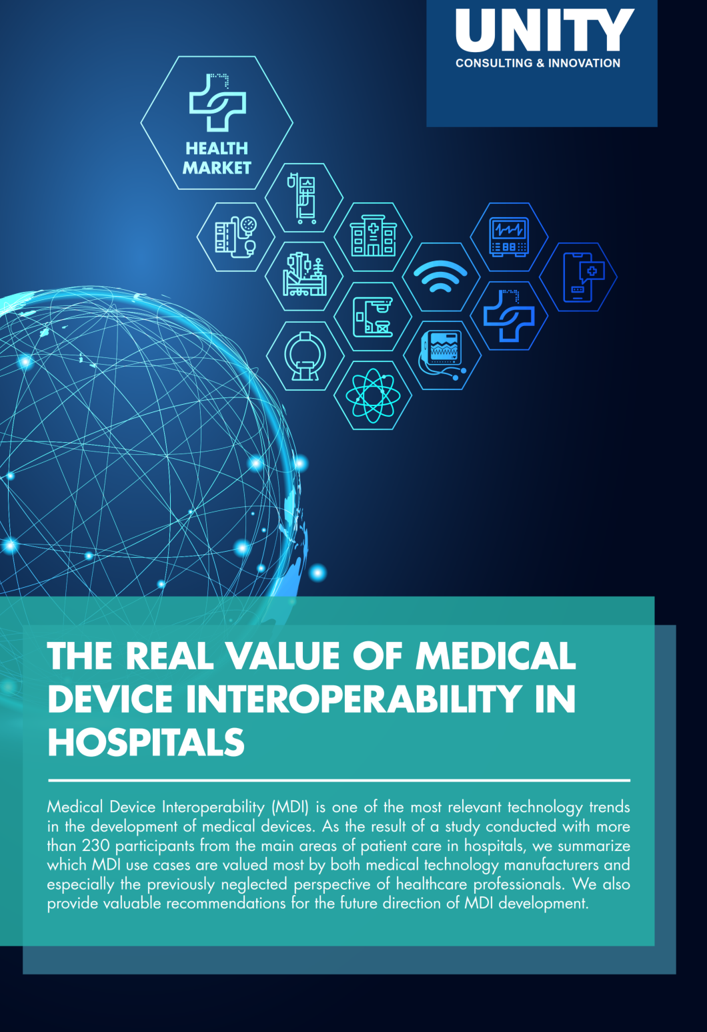
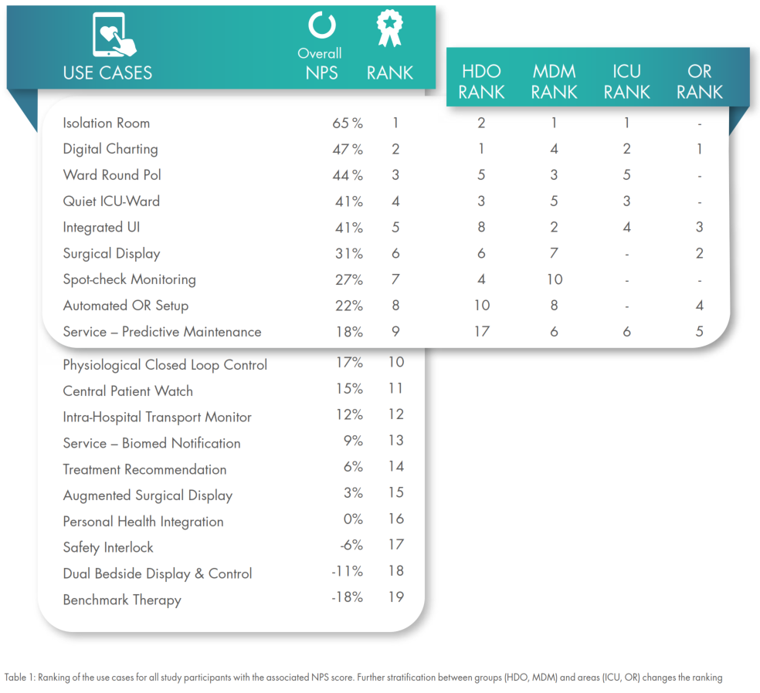
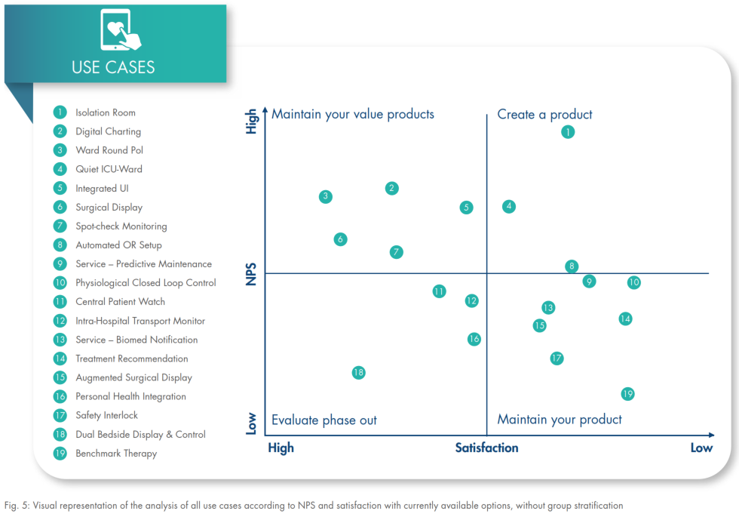
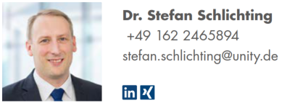
Updated Value of MDI Study

Slide 35
Gemini SES MDI – SES Ecosystem Pathway Launch
2022 January Update to IEEE/HL7 Working Group Meetings
Proposed September 2021, this new group will focus on the “SES” challenges for developing products along a pathway that includes ensuring system quality and risk management, along with regulatory affairs.

Slide 36
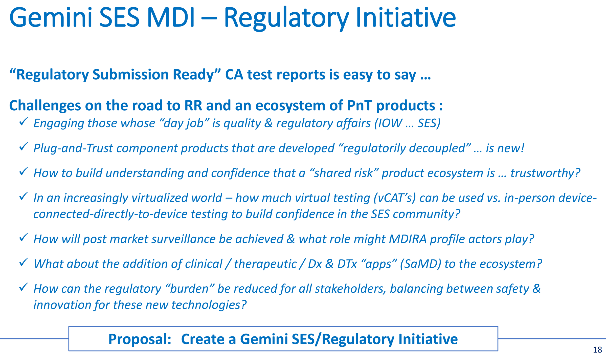
Gemini SES MDI – SES Ecosystem Pathway
Recognizing the need to advance the non-MDI tech … SES issues discussion, a new initiative was proposed during the 2021-09 WGM …
BUT
The “R” word was challenging!
The need was clear but the formal scope and ToR were challenging
SO
A group of key leaders met in October - December
Issues were discussed … at length! … and progress made!
Source: 2021-09 Gemini SES MDI Update to HL7 WGM
2022 January Update to IEEE/HL7 Working Group Meetings

Slide 37
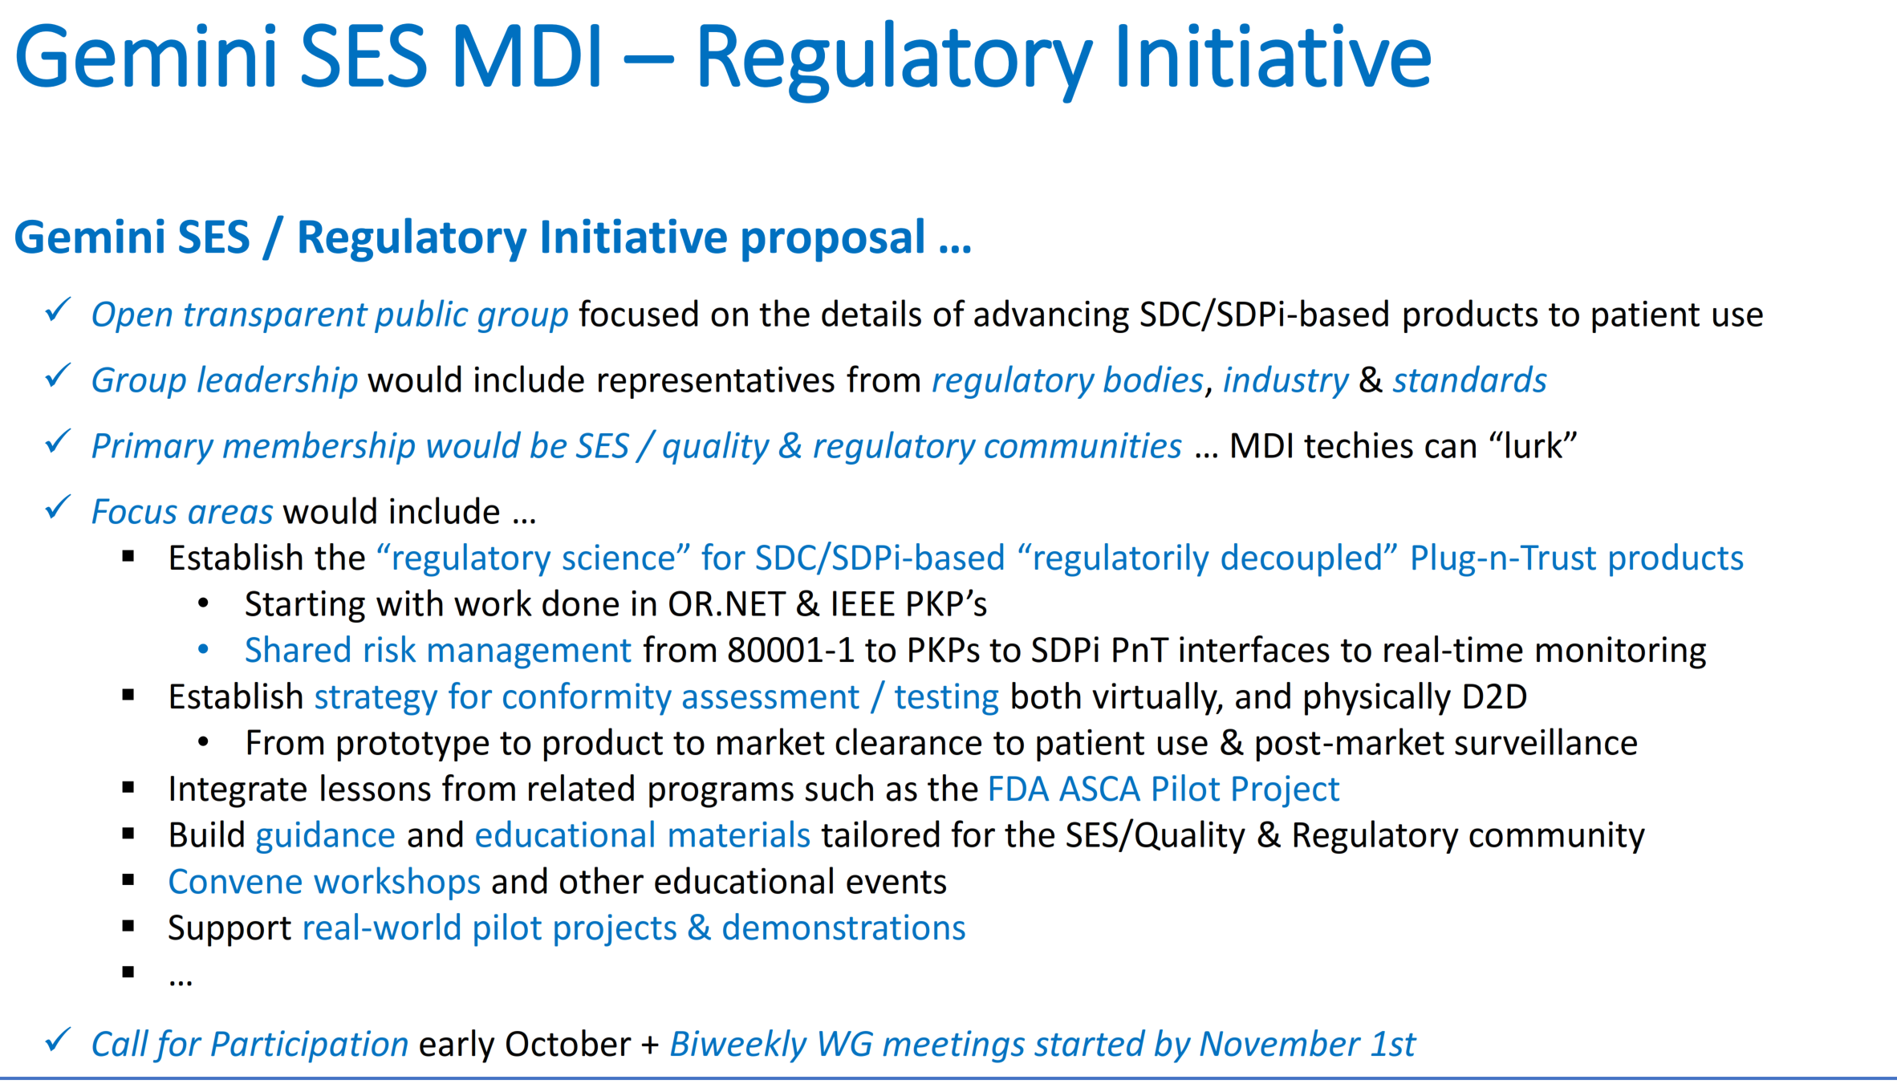
Gemini SES MDI – SES Ecosystem Pathway
Announcing a new Gemini SES MDI Group:
Ecosystem Pathway
(Pathway to an Ecosystem of Plug-and-Trust Products)
Participants: SES Product Quality / Risk Management / Regulatory Affairs Stakeholders
2022 January Update to IEEE/HL7 Working Group Meetings
Work focus: Issues related to decoupled product development & use … see EP ToI Table
Ecosystem Pathway Initiative
Launch:
Google Group Formed
Bi-weekly Zoom meetings (starting Feb 1st)
EP confluence home page (in development)
CALLING ALL SES EXPERTS!!!
Source: 2021-09 Gemini SES MDI Update to HL7 WGM

Slide 38
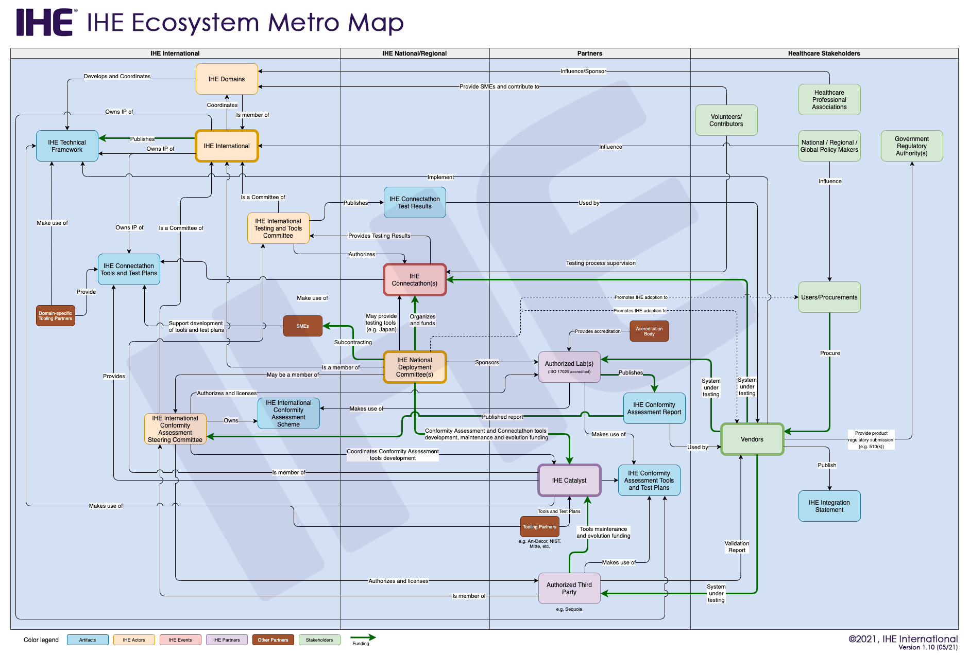
IHE Catalyst (formerly IHE EU/IHE Services)
Factoring in the IHE Testing Continuum & Ecosystem ….
2021.09 Gemini Update to IEEE-HL7 WGM
IHE Catalyst is central to all IHE based CA & Testing
Gemini program “home” considered for Catalyst or HL7
Study project (funded) being advanced with IHE Catalyst

Slide 39
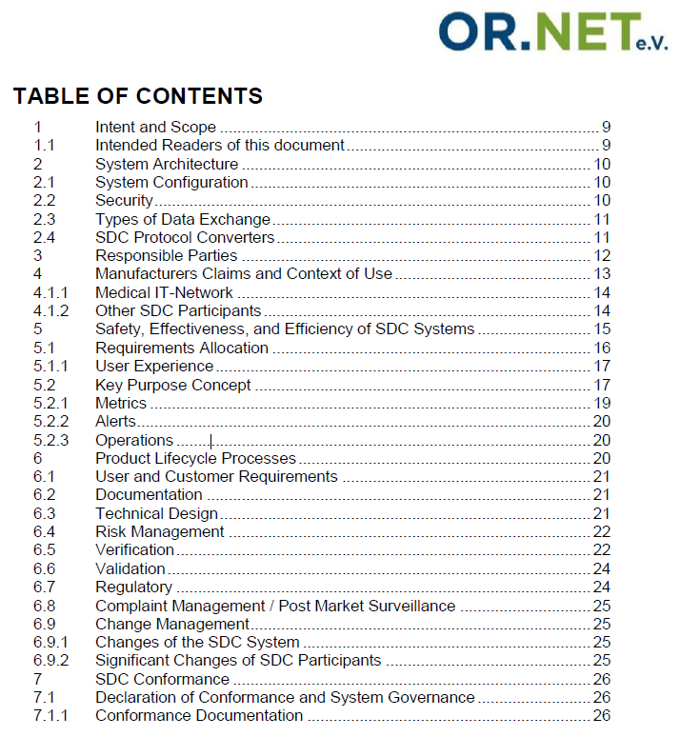
SDC Conformance Principles
OR.NET white paper lays foundation for traceability from PKPs to Conformity Assessment (CA) and certified safe-effective-secure (SES) interoperable medical device system components.
IHE SDPi Supplement TF-1 annex includes a summary of Conformance Principles
Download @
https://ornet.org/en/download/

Slide 40
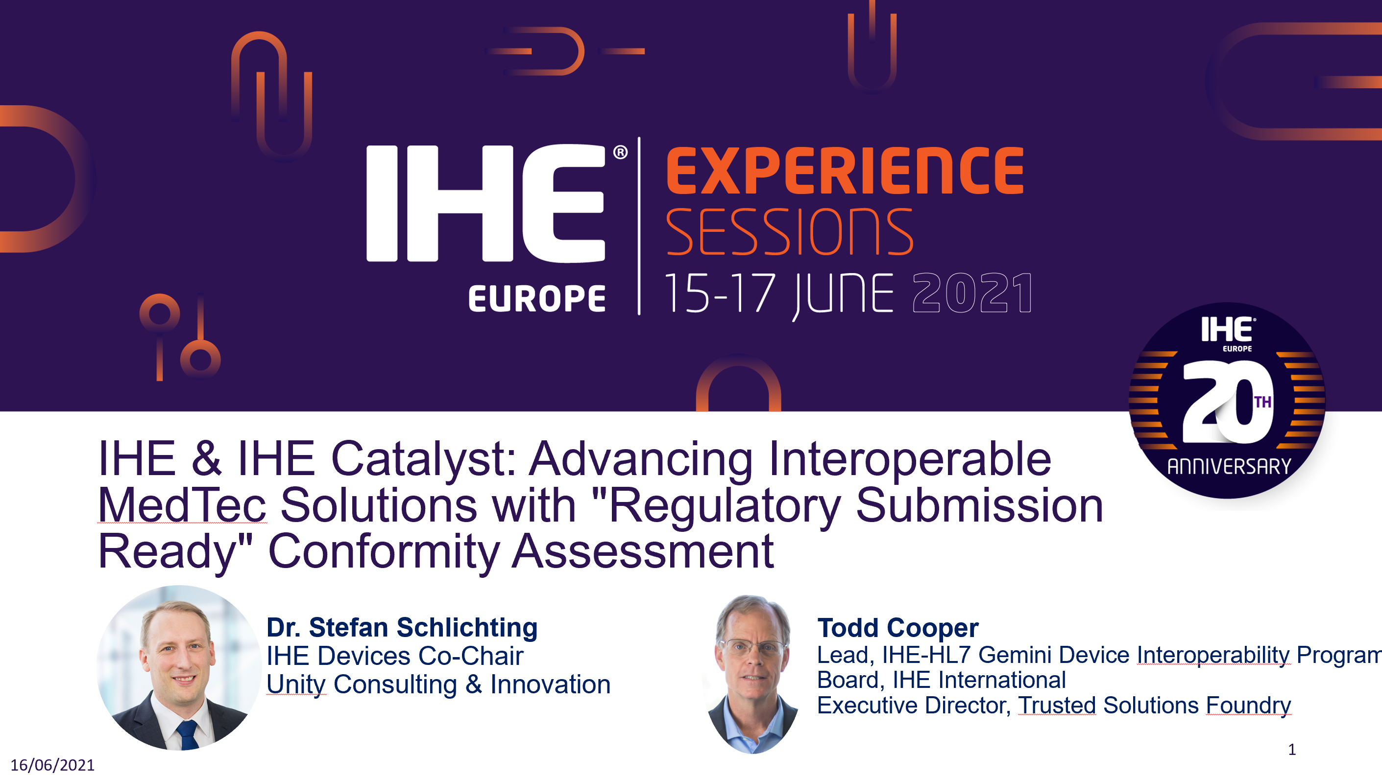
More detail is provided in …

Slide 41
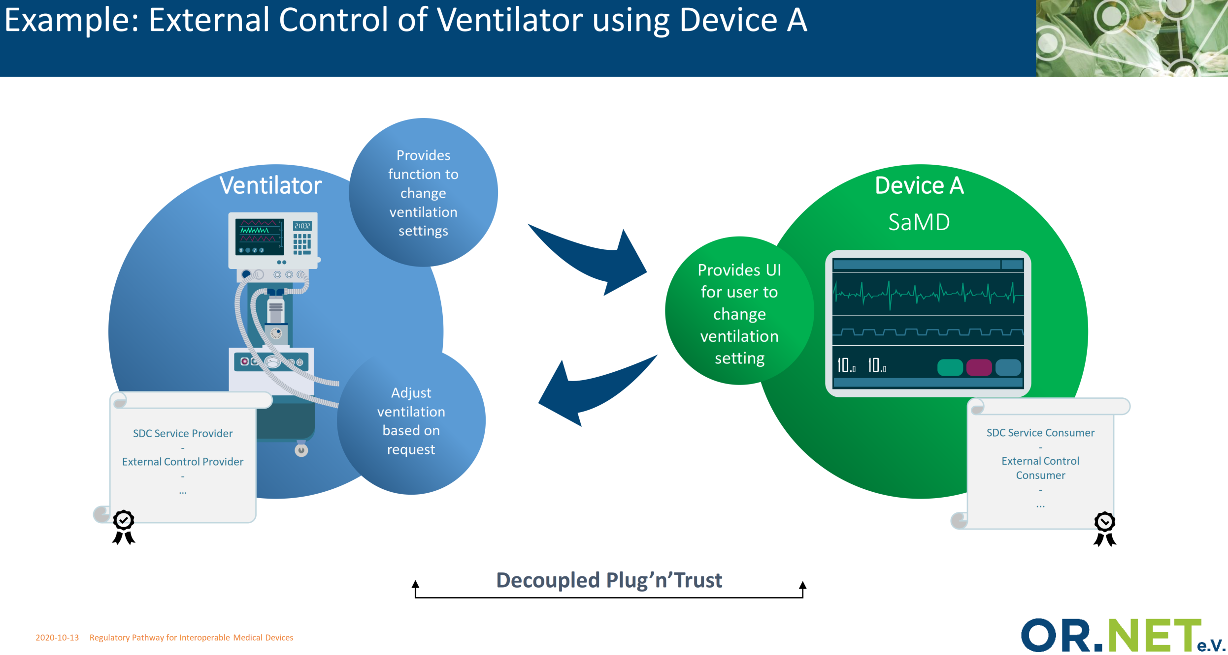
MedTech Regulatory Pathway – Core to SDC/SDPi Specifications

Slide 42
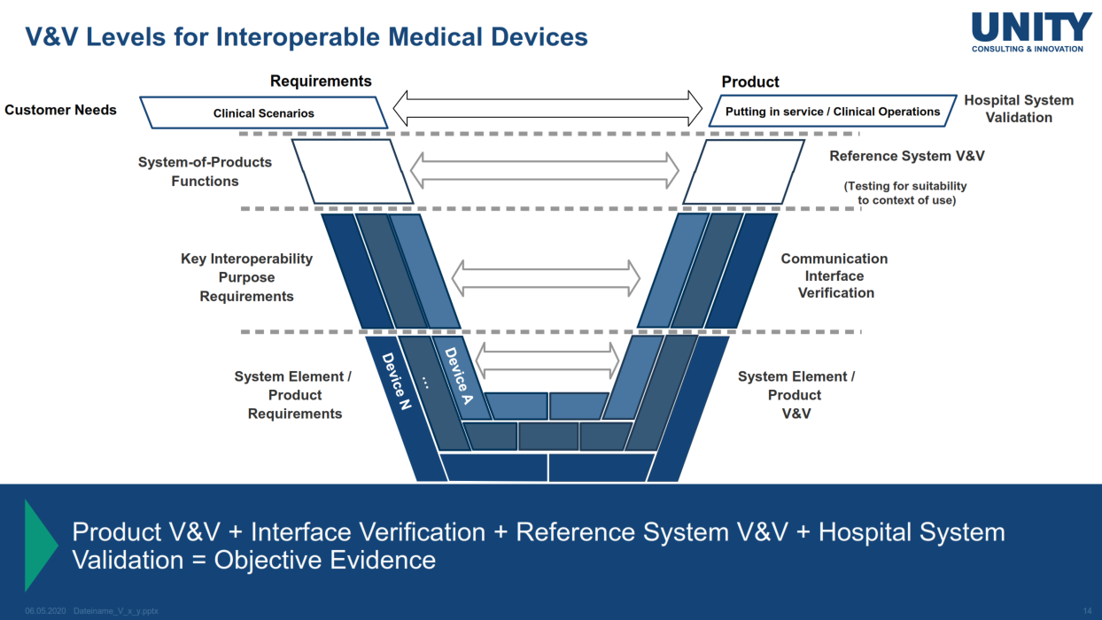
V-Model for Systems of MedTech Products
See IHE EU Experience ’21
… “Regulatory Submission Ready” CA

Slide 43
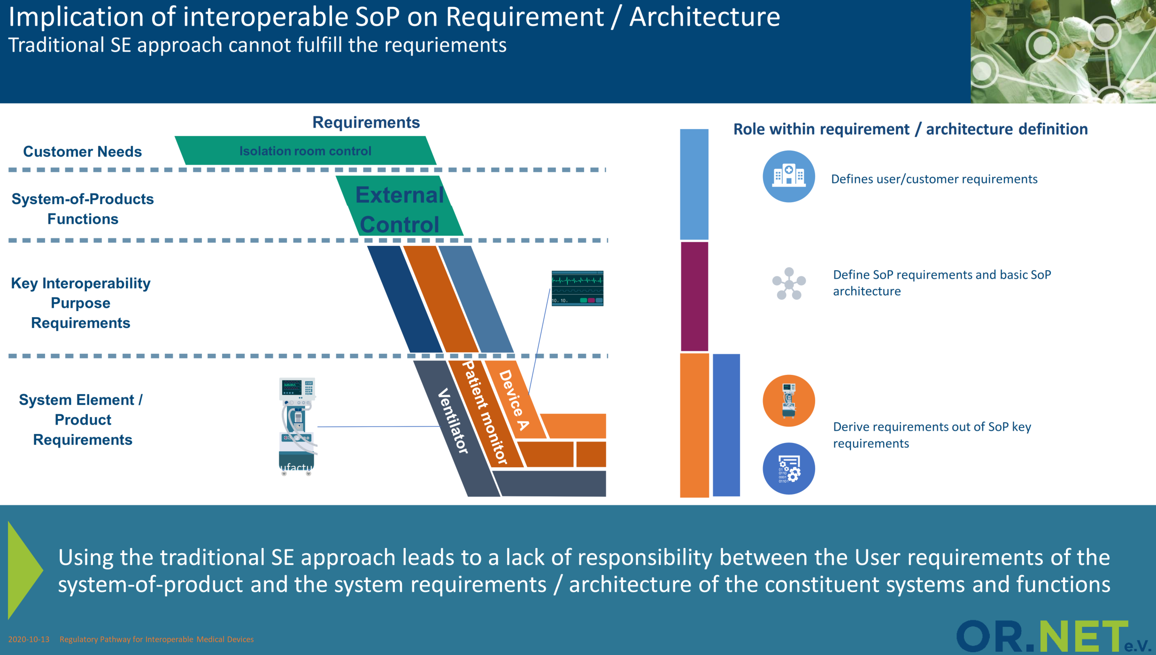
MedTech Regulatory Pathway – Core to SDC/SDPi Specifications

Slide 44
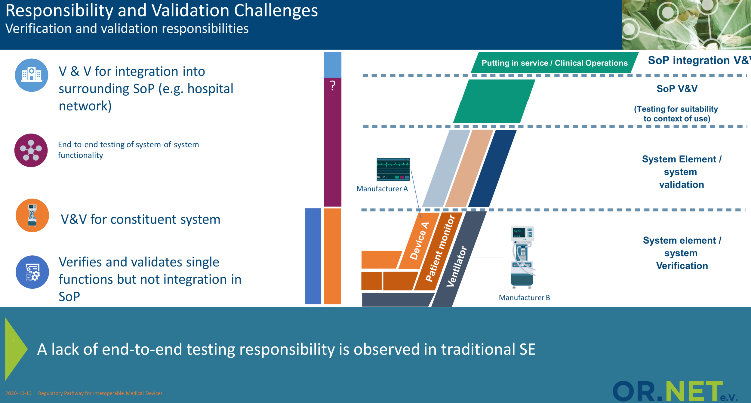
MedTech Regulatory Pathway – Core to SDC/SDPi Specifications

Slide 45
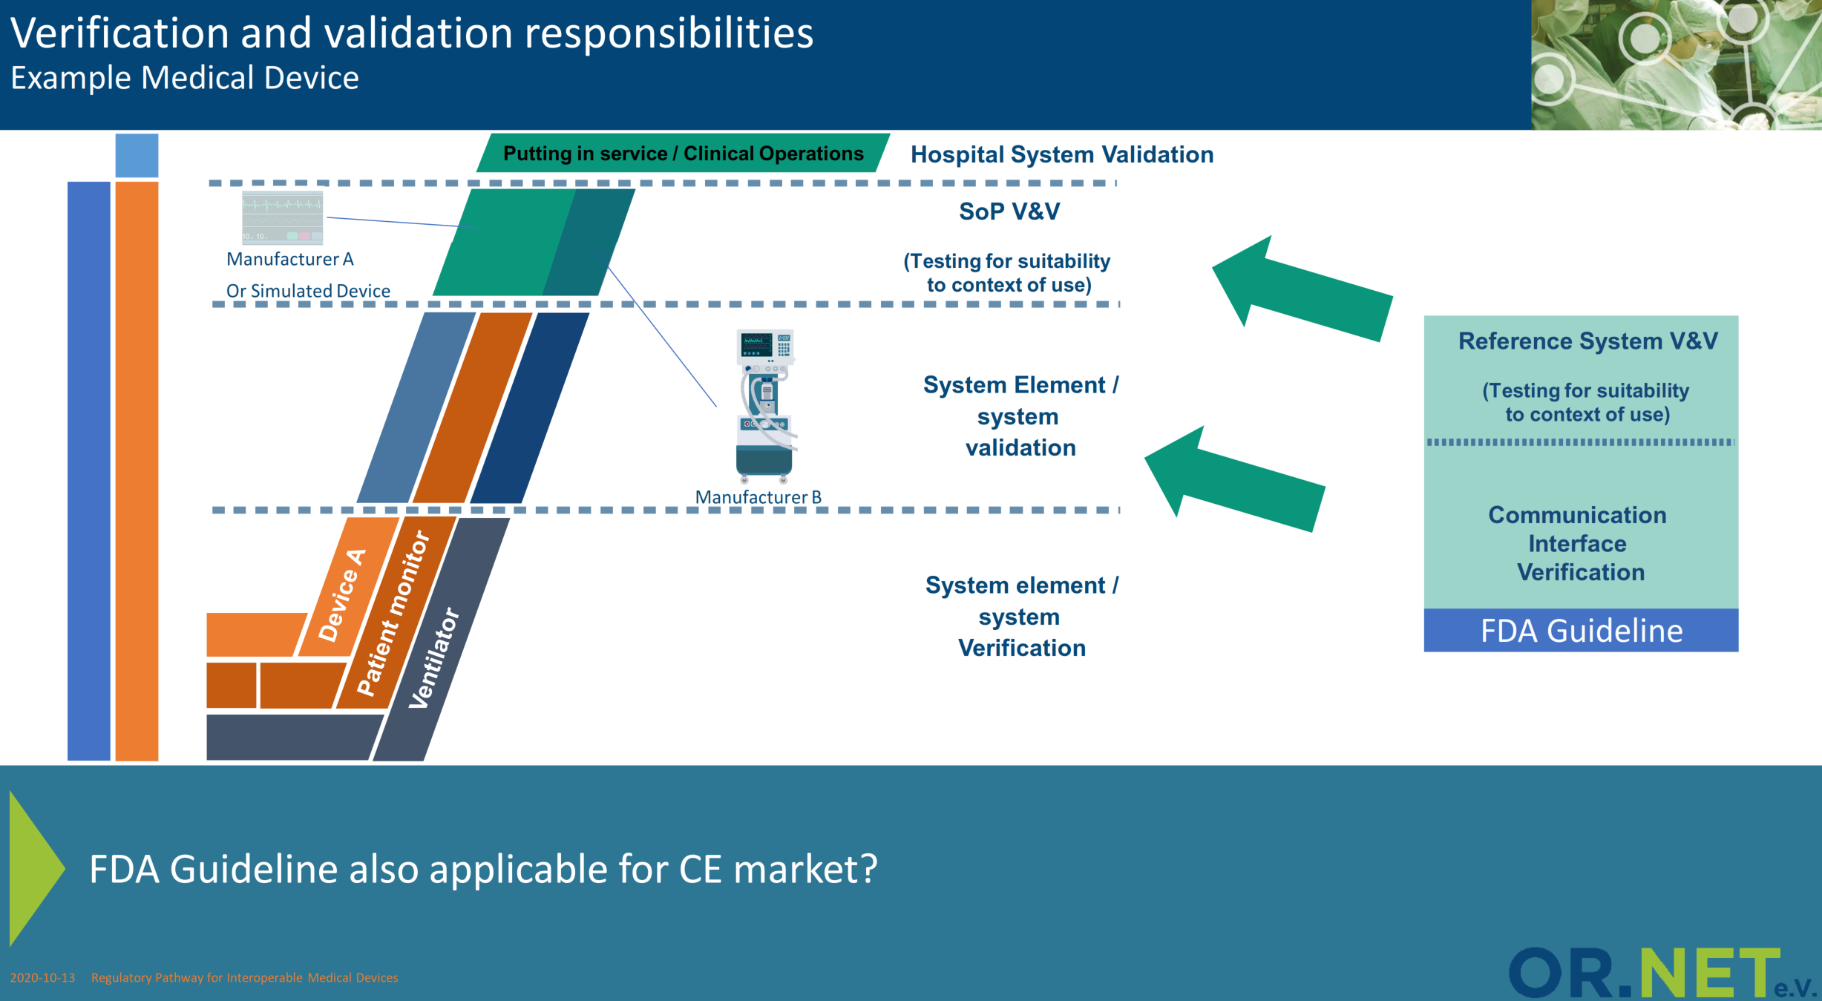
MedTech Regulatory Pathway – Core to SDC/SDPi Specifications

Slide 46
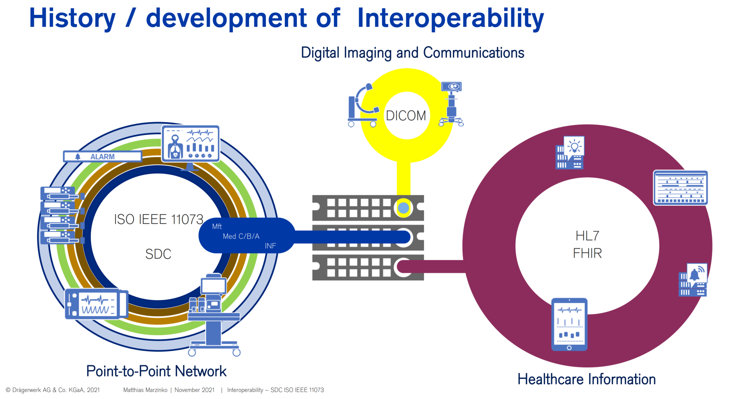
AdvaMed Briefing 2021 (Marzenko)

Slide 47
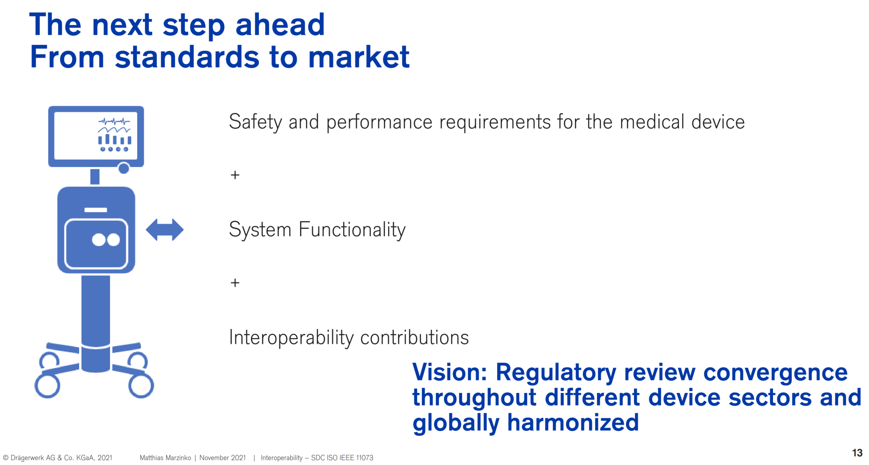
AdvaMed Briefing 2021 (Marzenko)

Slide 48
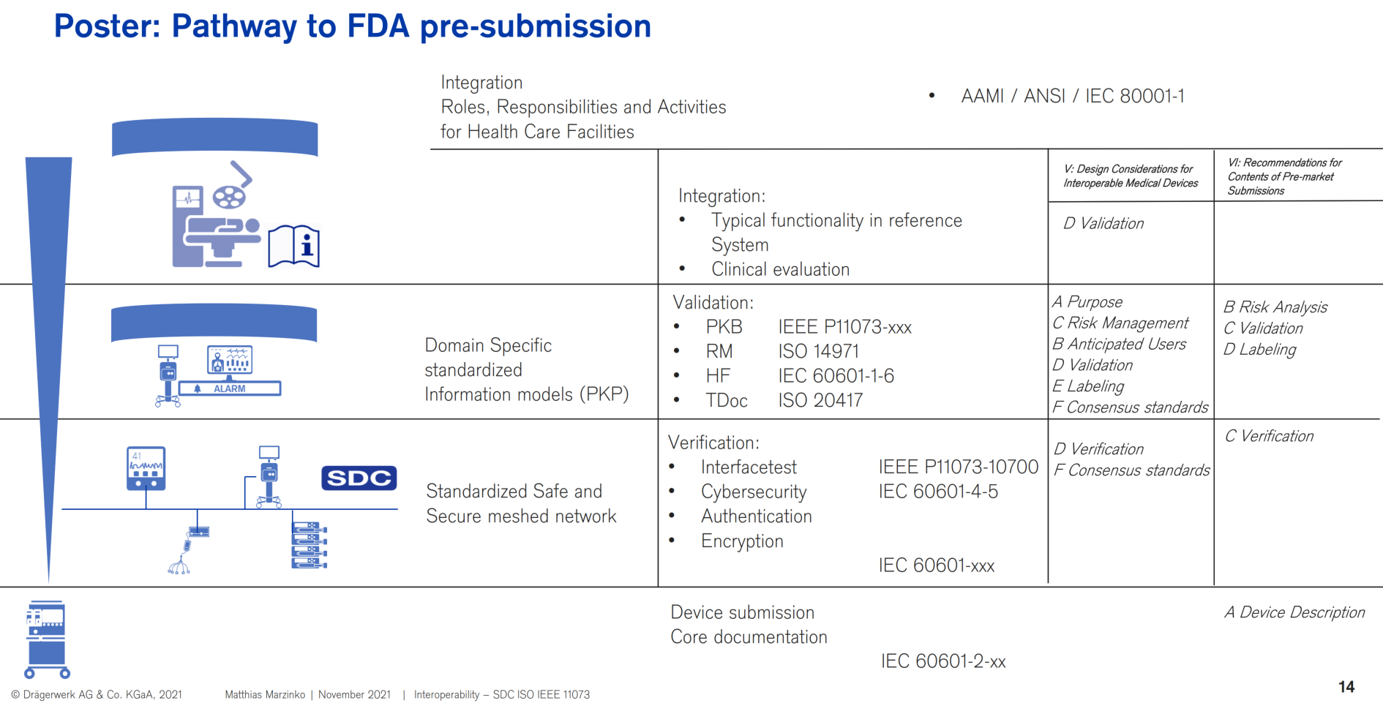
AdvaMed Briefing 2021 (Marzenko)

